Slide 1
CS 349
Final Project
CDs & Vinyls Dataset: Task 2
Ian Shi

Slide 2
Task 1: Feature Engineering
1
Unique Reviews
5
Image Percentage*
9
Negative
Total number of unique reviews each product received
Proportion of reviews per product that contained an image
Mean negative sentiment of each review/summary for a specific product
2
Mean Upvote Rate
6
Sentiment
10
Sentiment Threshold
Average number of upvotes across the reviews per product
Average sentiment across product reviews and summaries
Overall sentiment of a product based on its reviews/summaries (0, 1).
3
Verification
7
Compound
11
Sentiment Ratio
Proportion of reviews submitted by verified users per product
Mean compound sentiment of each review/summary for a specific product
Ratio of each products positive to negative sentiment
4
Earliest Review
8
Positive
12
Review vs Summary
Provides timestamp for the earliest review each product received
Mean positive sentiment of each review/summary for a specific product
Each products review vs summary sentiment ratio
*This feature was bugged in task 1, fixed in task 2

Slide 3
Task 1: Hyperparameter Optimization
Recursive Feature Elimination
Grid Search
Sklearn’s RFECV function was used to to recursively test which features chosen during our feature engineering step should be prioritized in our model
Each feature is tested on a 10-fold cross-validation
Feature rankings are recorded, giving us a list of features for each model that should be used
Sklearn’s GridSearchCV function was used to iteratively test different hyperparameters for each relevant model
Each hyperparameter pair was tested on a 10-fold cross-validation, with their mean F1 score recorded
Collected data was exported to a .csv file where we could analyze which set of hyperparameters gave us the best results

Slide 4
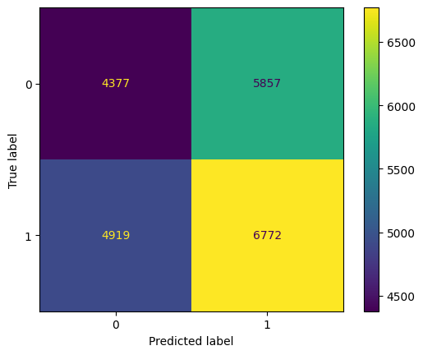
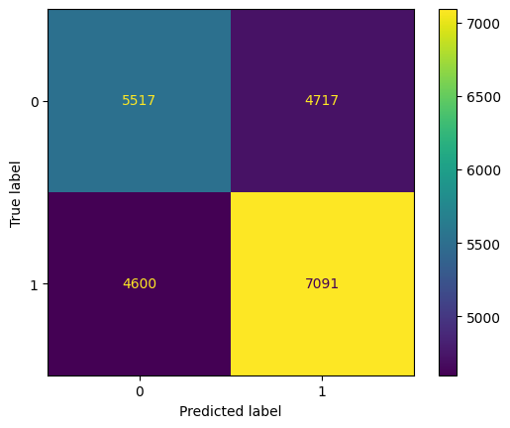
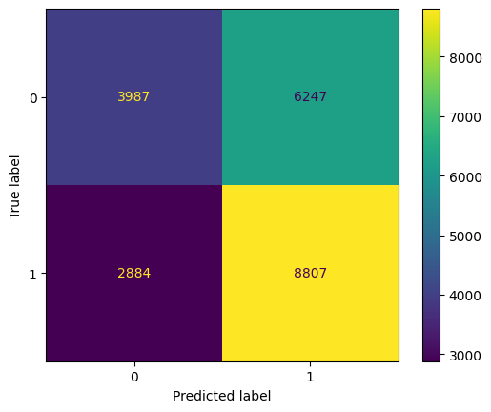
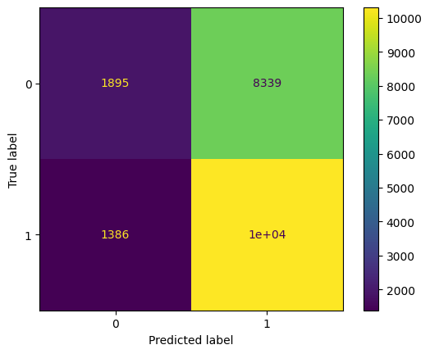
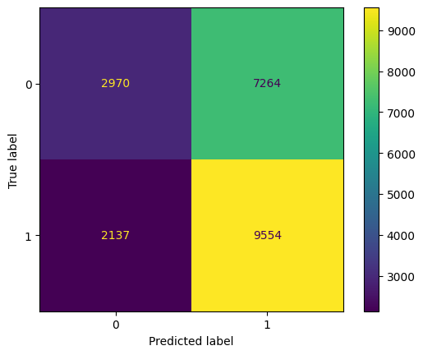
Task 1: Model Performance
K Nearest Neighbors
Gaussian NB
Decision Tree
SVM
N_neighbors: 9 | weights: uniform
Criterion: entropy | max_depth = 3
Kernel: rfb
Precision: 0.54 | Recall: 0.58 F1 Score: 0.56
Precision: 0.60 | Recall: 0.61 F1 Score: 0.60
Precision: 0.59 | Recall: 0.75 F1 Score: 0.66
Precision: 0.55 | Recall: 0.88 F1 Score: 0.68
Random Forest
max_depth: 1 | n_estimators: 28
Precision: 0.57 | Recall: 0.82 F1 Score: 0.68
Features: ['verified', 'rev_posSentiment', 'rev_negSentiment', 'summ_negSentiment', 'rev_posNegRatio', 'summ_posNegRatio', 'summToRev']

Slide 5
Task 2: Feature Engineering
1
Length of Review
4
Total Reviews
Average number of words contained in each review per product
Total number of raw reviews per product (task 1 contained total unique reviews)
2
Normalized Time
5
Max Upvotes
Issue with task 1 “earliest review” feature: scale was too high. Normalizing prevents that*
Maximum number of upvotes on a product’s review page
3
Review Period
Time between first and last review of product (normalized).
*Normalizing/scaling done using sklearn MinMaxScale()

Slide 6
Task 2: New Algorithms & Methods
1
New Feature Generation
Task 1 algorithms using new features
2
Logistic Regression
Logistic regression algorithm using scikit learn
3
Adaboost
Adaboost algorithm using scikit learn
4
Late Fusion
Ensemble method using scikit learn

Slide 7
Task 2: Hyperparameter Optimization
Recursive Feature Elimination
Grid Search
Randomized Search
Sklearn’s RFECV function was used to to recursively test which features chosen during our feature engineering step should be prioritized in our model
Each feature is tested on a 10-fold cross-validation
Feature rankings are recorded, giving us a list of features for each model that should be used
For task 2, we added 5 new features and fixed a broken feature (image) from task 1
Also created RFE functions for classifiers w/o RFECV support
Sklearn’s GridSearchCV function was used to iteratively test different hyperparameters for each relevant model
Each hyperparameter pair was tested on a 10-fold cross-validation, with their mean F1 score recorded
Collected data was exported to a .csv file where we could analyze which set of hyperparameters gave us the best results
Sklearn’s RandomizedSearchCV function was used as another optimization method
Compared to Grid Search (which tests every combination), Randomized Search randomly selects combinations from a given subset. This is beneficial when testing on larger datasets like ours
Each hyperparameter pair was tested on a 10-fold cross-validation, with their mean F1 score recorded

Slide 8
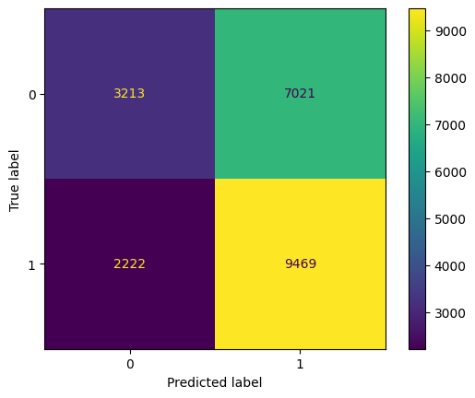


Task 2: Model Performance
Part 1: Rerun Task 1 models & hyperparameter optimization with new and fixed features
Random Forest
Decision Tree
Gaussian NB
max_depth: 1 | n_estimators: 28
max_depth: 5
Features : all
Features: ['verified', 'rev_negSentiment', 'summ_negSentiment', 'total_reviews', 'norm_time_diff']
Features: ['vote', 'verified', 'rev_Sentiment', 'rev_posSentiment', 'rev_negSentiment', 'summ_negSentiment', image', 'rev_posNegRatio', 'normalized_time', 'max_upvote', 'norm_time_diff']
Precision: 0.57 | Recall: 0.81 | F1 Score: 0.67
Precision: 0.59 | Recall: 0.75 | F1 Score: 0.66
Precision: 0.59 | Recall: 0.73 | F1 Score: 0.66

Slide 9
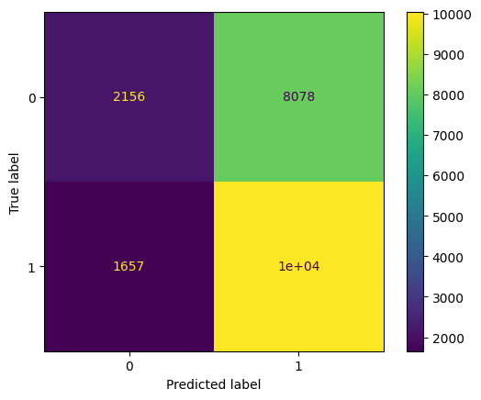
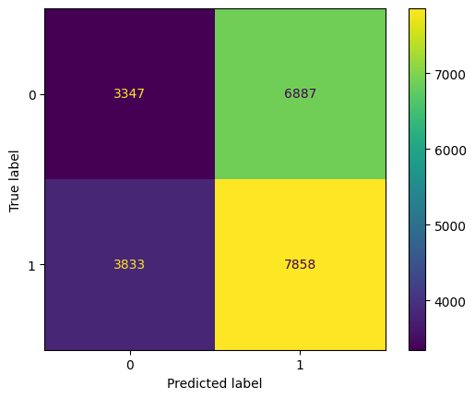
Task 2: Model Performance (cont.)
Part 2: Implement new classifiers & algorithms
Logistic Regression
Adaboost
fit_intercept: False | solver: 'sag' | multi_class: 'multinomial'
classifiers: Gaussian NB, Decision Tree, Random Forest, Logistic Regression
Features : ['reviewerID', 'vote', 'verified', 'rev_Sentiment', 'summ_compSentiment', 'rev_posSentiment', 'summ_posSentiment', 'rev_negSentiment', 'summ_negSentiment', 'image', 'rev_posNegRatio', 'summ_posNegRatio', 'summToRev', 'normalized_time', 'max_upvote', 'av_word_count', 'total_reviews', 'norm_time_diff']
Features: all
Precision: 0.55 | Recall: 0.86 | F1 Score: 0.67
Precision: 0.53 | Recall: 0.67 | F1 Score: 0.59

Slide 10
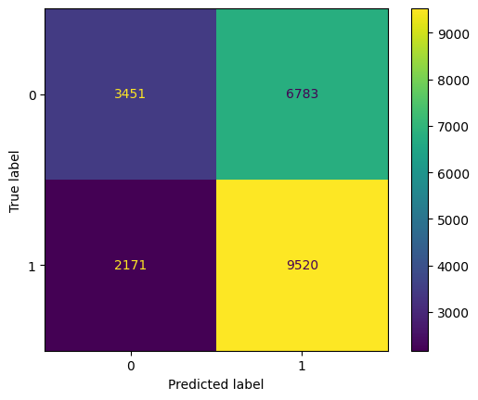
Task 2: Model Performance (cont.)
Part 3: Late Fusion with VotingClassifier() to create final classification model
Late Fusion
estimators = random forest, decision tree, logistic regression
Features: all
Precision: 0.58 | Recall: 0.61 | F1 Score: 0.69

Slide 11
Areas of Concern
Overall, our training model performance was again not as optimal as we would have liked (unable to achieve an F1 score above 0.7, relatively low precision)
These may have to do with suboptimal features
If given more time on this project, we would have liked to explore more feature options
Our implementation of Adaboost ran into issues with changing the number of features used with each classifier, preventing us from using our results from feature optimization
This may have negatively impacted the ability of Adaboost to improve its predictions
Some classifiers have particularly inaccurate results when using all features
E.g., logistic regression sorts all vectors into 1
More information on the next slide

Slide 12
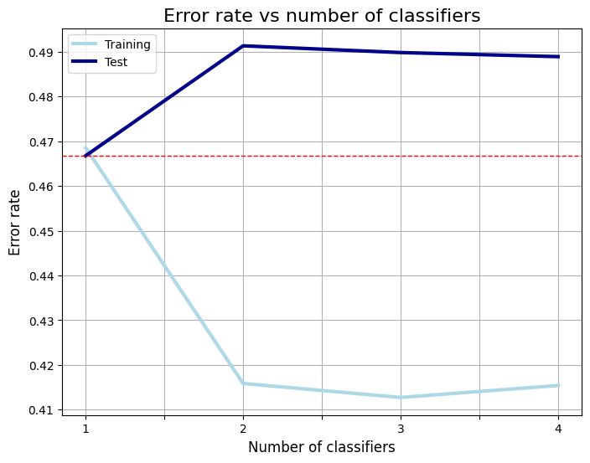
Areas of Concern (cont.)
Aside: Adaboost
Adaboost Error
After implementing Adaboost for testing multiple classifiers, we calculated error rate based on the number of classifiers included in the boosting
Data was split into training (70%) and testing (30%)
While performance improved when training and boosting the classifiers, it appears the boosting actually increased error while boosting on the test data

Slide 13
Next Steps
Neural Networks & Deep Learning
Parts 1 & 2 of the final project were restricted to binary classifiers, which performed mediocre on the task of predicting “awesome” vs “not awesome” products based on the information given
In the individual portion, exploring different neural network and deep learning algorithms--while adding complexity--could help the performance of our model
Sentiment Analysis
Feature Engineering
Sentiment analysis was one of the biggest “black-box” unknowns during our preprocessing stage
Trying different models such as TF-IDF, or spaCY instead of nltk could product different or more accurate results
The features we chose gave mean results that made it hard to distinguish between “awesome” and “not awesome” products. While task 2 refined and added new features, it will be important to continue to develop and monitor the best features to extract from our dataset

